Slide 1
Cohort Analysis¶ Cohort analysis is a tool to measure user engagement over time. It helps to know whether user engagement is actually getting better over time or is only appearing to improve because of growth.

Slide 2
Two main benefits of reading the above cohort table, are: 1)product lifetime (as depicted vertically down in the table) – comparing different cohorts at the same stage in their life cycle – we can see what % of people in a cohort are coming back to app after 3 days and so on. The early lifetime months can be linked to the quality of your onboarding experience and the performance of customer success team. 2)user lifetime (as depicted horizontally to the right of the table) – seeing the long term relationship with people in any cohort – to ascertain how long people are coming back and how strong or how valuable that cohort is. This can be presumably linked to something like the quality of the product, operations, and customer support.

Slide 3
Step 1:¶ Calculate the 2nd day, 7th day and 10th day retention . Retention = Percentage of people that downloaded the game on day 1 also who played again on day 2, 7 and day 10. Two way retention calculation, 1) using the user id (user_id) 2) using the device id (client_mobile_device_aid) (Please note that you only have the device id from the 14th of April)

Slide 4
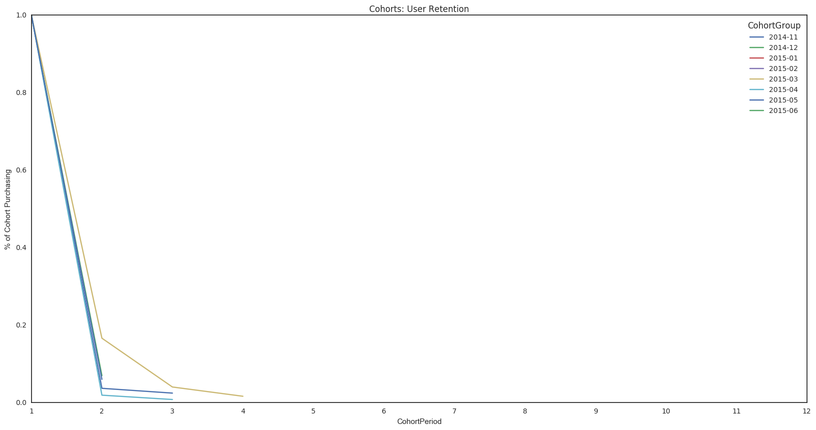
Process Part1: Since we're doing monthly cohorts, we'll be looking at the total monthly behavior of our users. Therefore, we don't want granular datetime data (right now). Since we're looking at cohorts divided into months, we need to aggregate users, orders, and amount spent by the CohortGroup within the month (OrderPeriod).
Conclution from Overall Cohort Analysis:¶
March 2015 and December 2014 Has been most successful in retaing customers after 2nd day.¶
First half of 2015 has been 2 Times better than what we notice in later part of 2014.¶

Slide 5
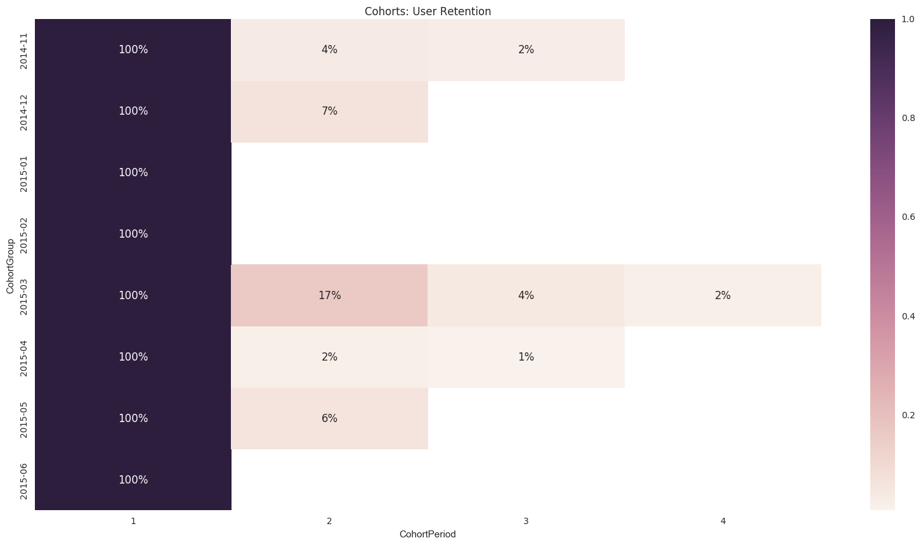
Monthly Retention Over 2 Years

Slide 6
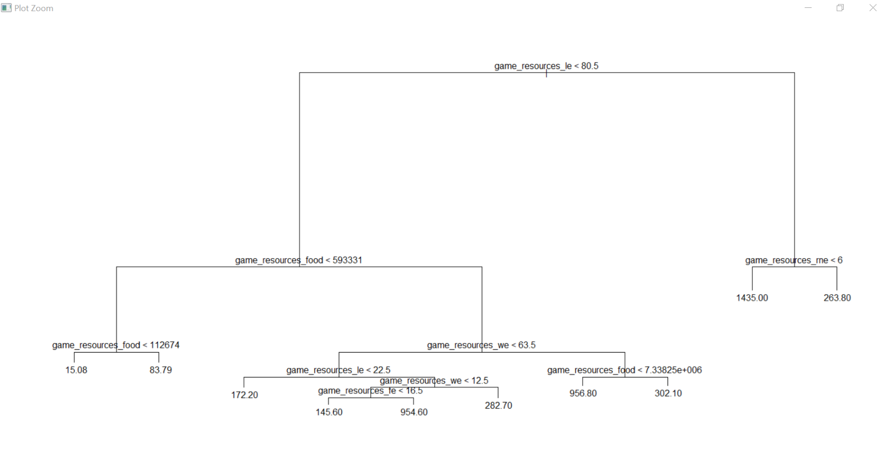
Tree: The Tree Diagram below shows how many times a player will likely play again

Slide 7
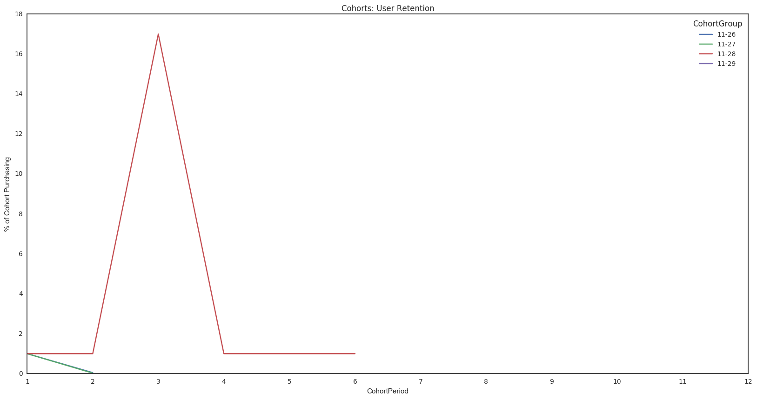
Cohort Analysis based on Users Joining day: November 2014
Conclution for November 2014:¶
The game was first used by users only on four days - 26th,27th,28th and 29th¶
Users who joined 28th were retained successfully for upto 4days.
Return Customers are noticed on third since first joining on 28th November¶

Slide 8
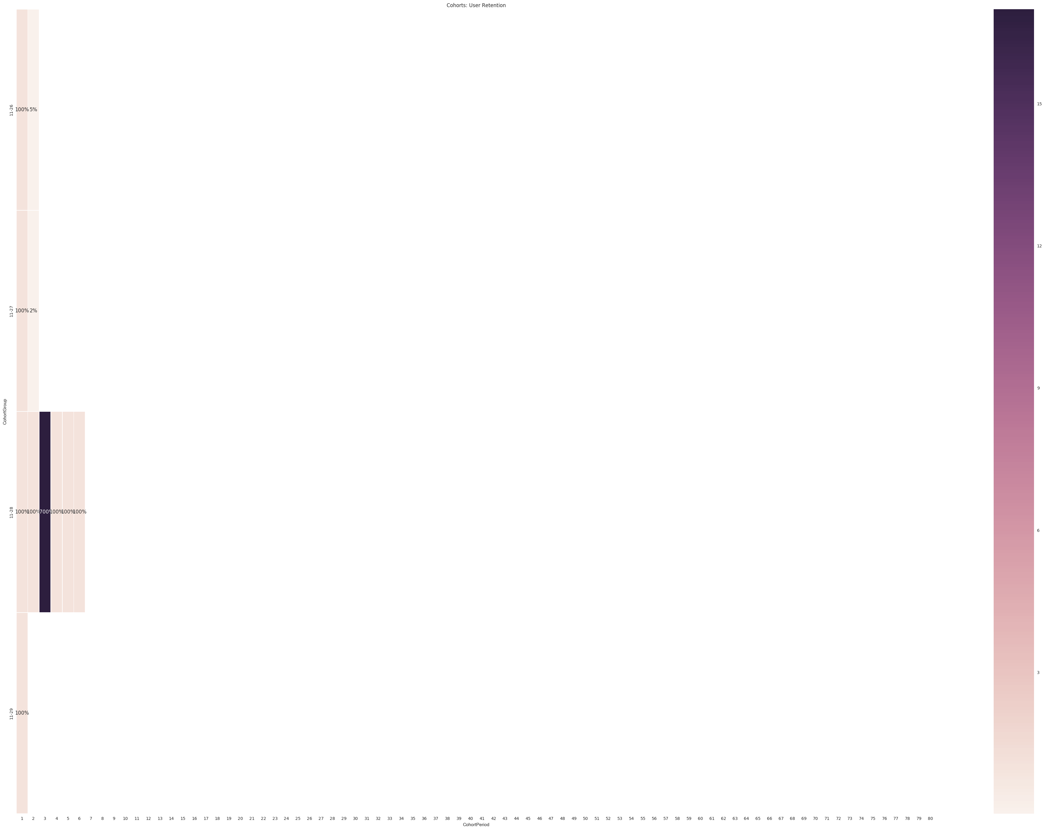

Slide 9
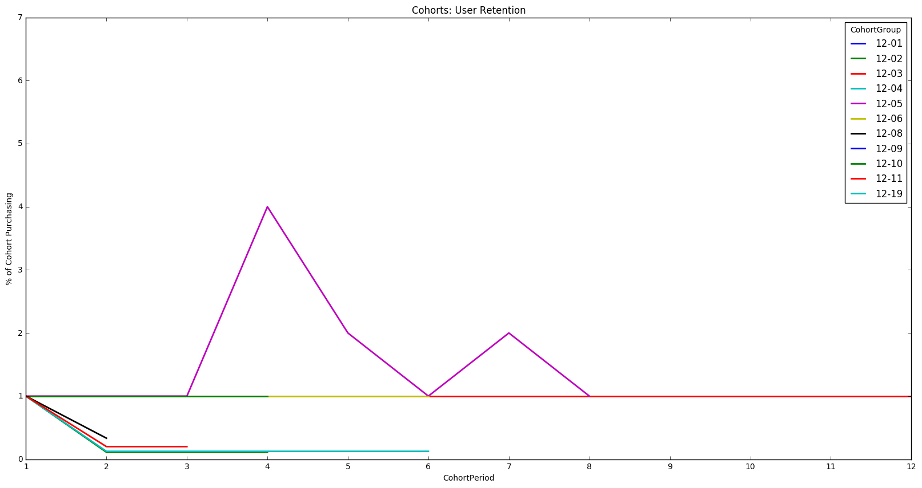
Cohort Analysis based on Users Joining day: December 2014
Conclution Dec 2014:¶
Almost 80% of the users are retained upto 1 week of first playing the game.¶
Many repurchases came around 3rd day for customers who joined on 5th of December.¶
69% of the users joined the application in 1st week of Dec 2014,¶
Almost 100% of the users were retained on most of the days.¶
.

Slide 10
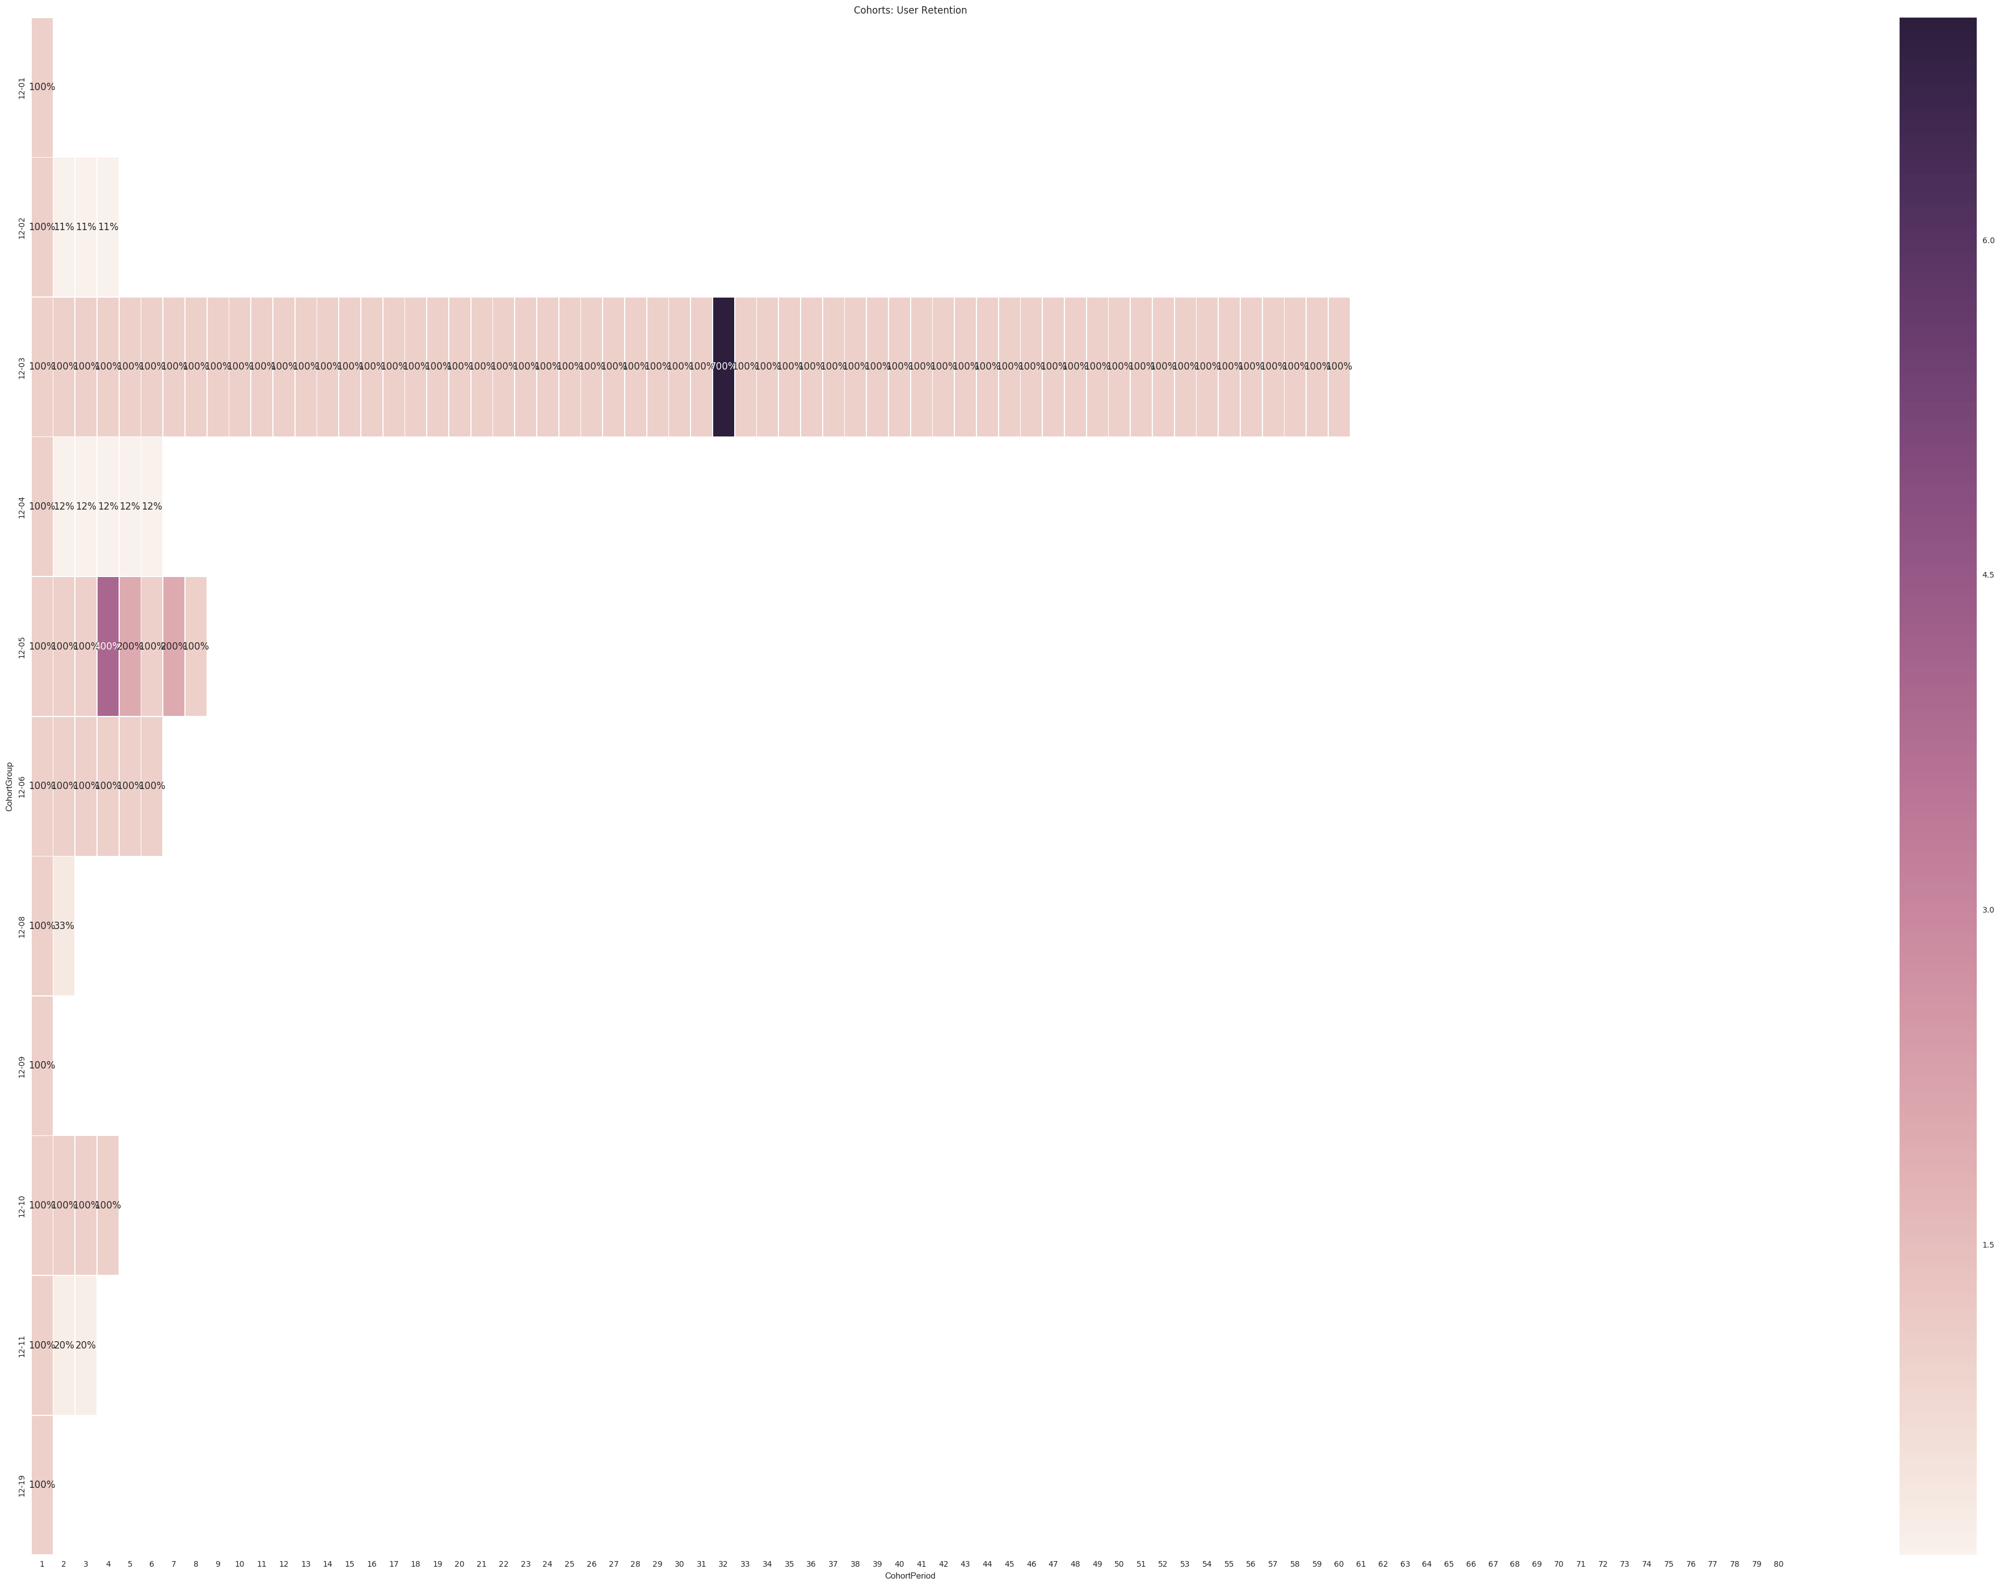

Slide 11
Cohort Analysis based on Users Joining day: January 2015
Conclution Jan:¶
100% For 1st day, then Zero for rest¶
0% of the users were retained after 1st day¶
Users only joined on two days - 7th and 8th of January.¶

Slide 12
Cohort Analysis based on Users Joining day: February 2014
Conclution Feb¶:
100% For 1st day, then Zero for rest¶
0% Users were retained after 1st day.¶
Users used the application only on 13th and 26th of Feb.¶

Slide 13
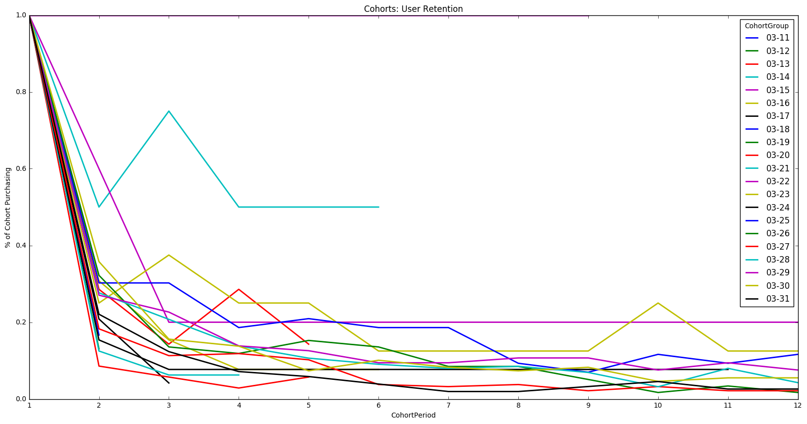
Cohort Analysis based on Users Joining day: March 2014
45% of customers are retained on 2nd day who visited after first 10 days of the month.¶
5%-10% Users were retained for more than 12 days.¶
Most successful Month for the application so far.¶
1) Users who joined on 15th of March were retained 100% for 8 days.¶
2) More users stayed who joined later in the month, mostly after 2nd week.¶
3) All users left on 1st day in the first week which is not seen in later months to come.¶

Slide 14
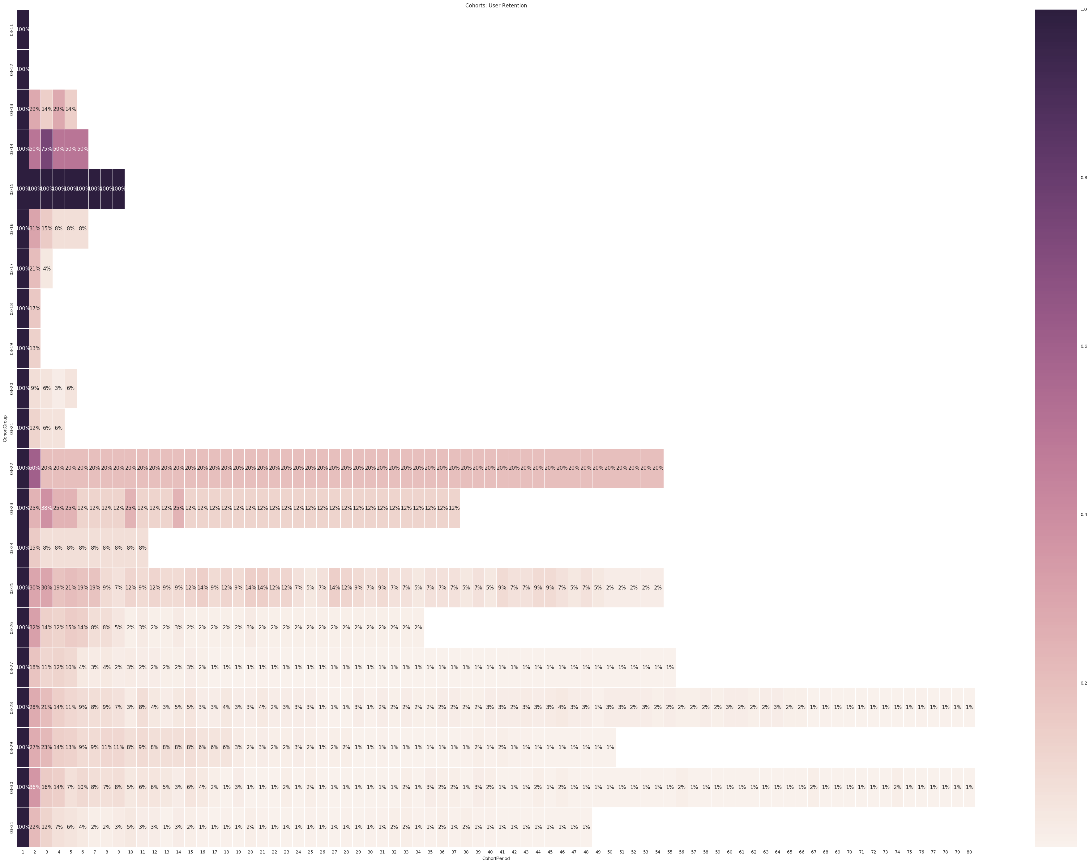

Slide 15
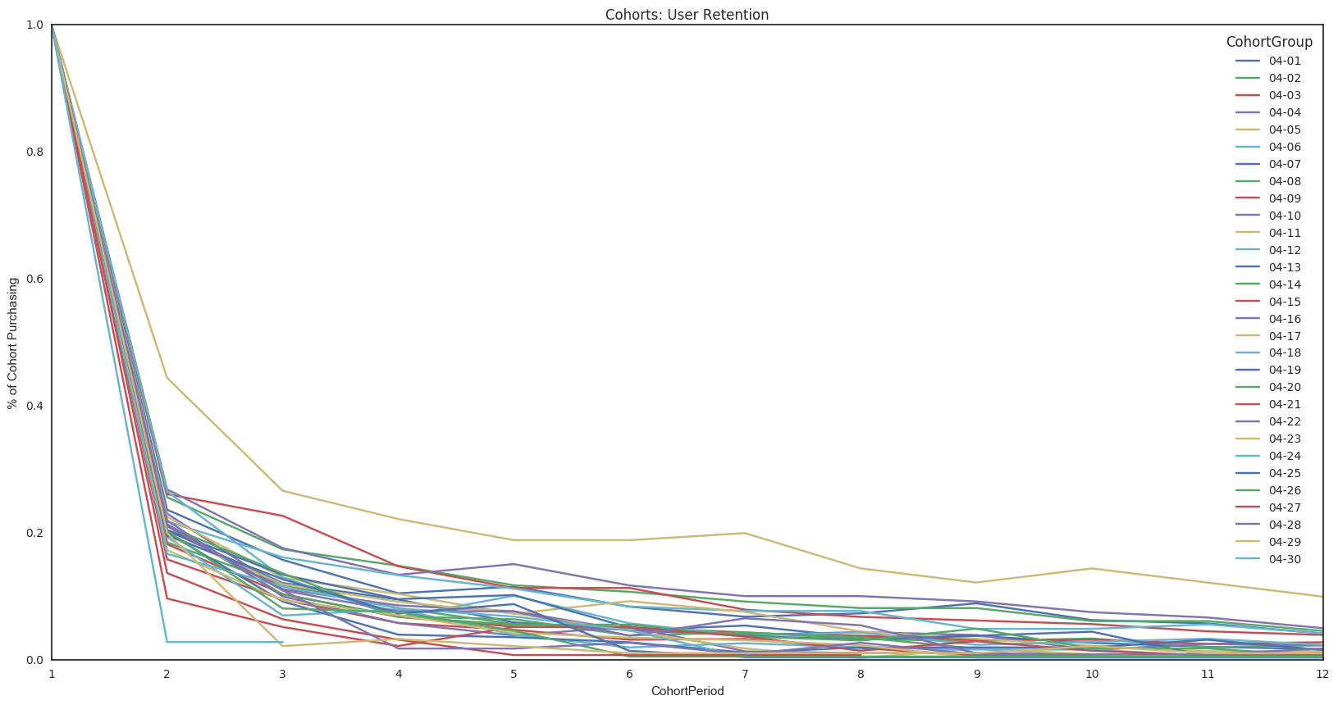
Cohort Analysis based on Users Joining day: April 2015
Conclution April:¶
Most users leave by second day of joining 1% stay upto 12+ days
1) 80%-85% of Users leave after 1st day.¶
2) Retention of 1%-2% Users till 50-60 days.¶
3) 5th day of April has been the most succesful day, users who joined on 5th of April, 25% were retained upto 3rd day, and 12% were retained upto 10-12 days

Slide 16
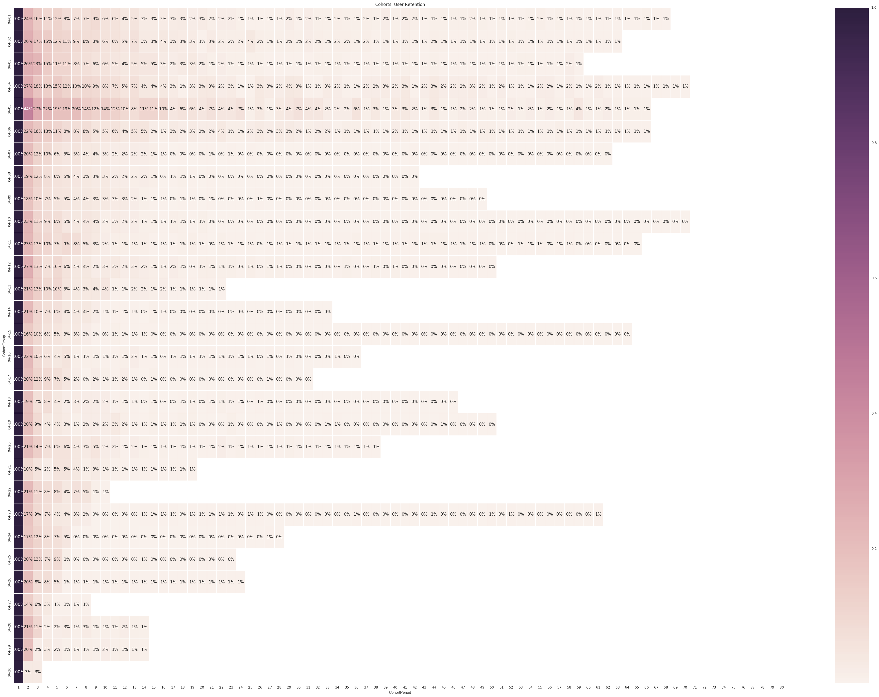

Slide 17
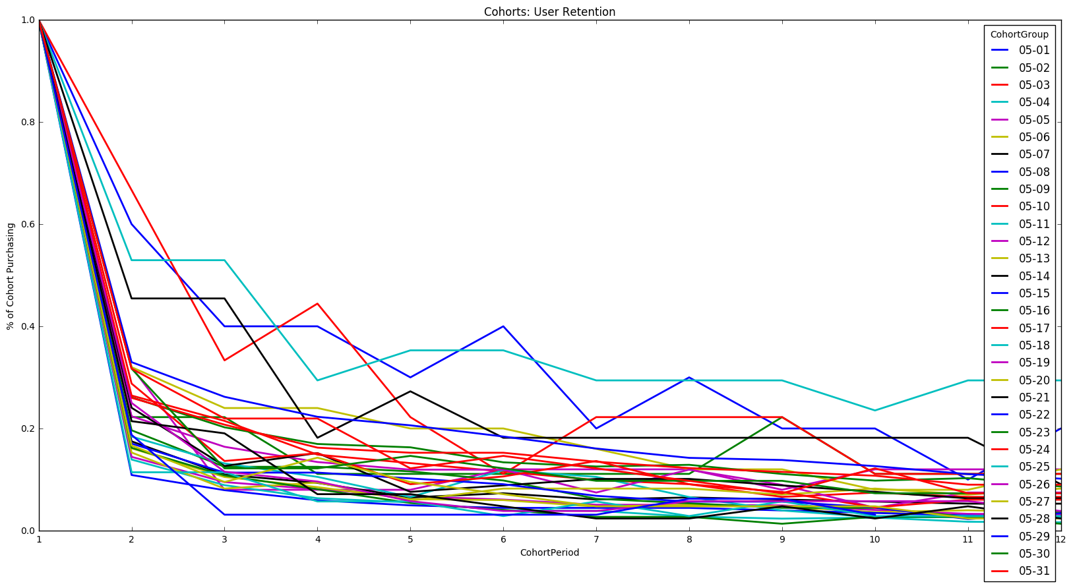
Cohort Analysis based on Users Joining day: May 2015
Conclusion May:¶
30% users are retained till 3rd day, and 40 %Users are retained till 2nd day.¶
User make purchases between 7 to 5 days difference.¶
1) Retention rate is almost 40% for 2nd day.¶
2) 5%-10% Return Users are noticed even after 1 week of last visit.¶
3) Retention is noticed between 10-45 days from the day of start.¶

Slide 18
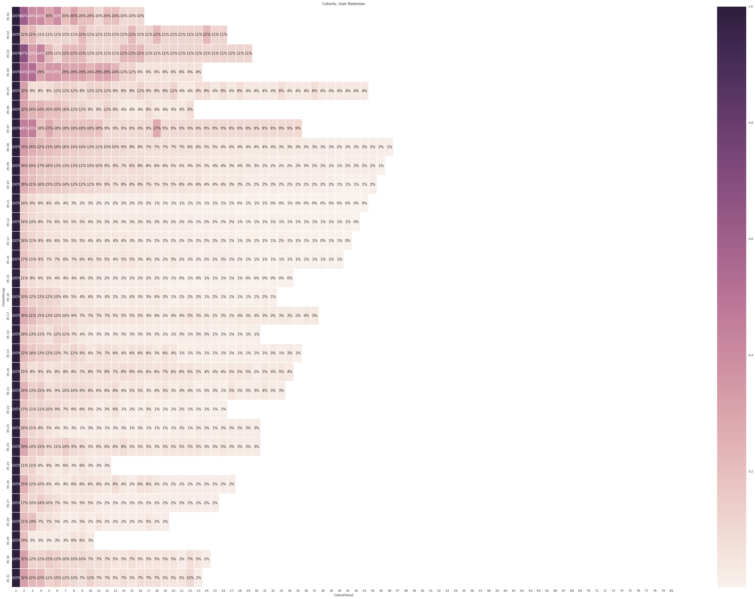

Slide 19
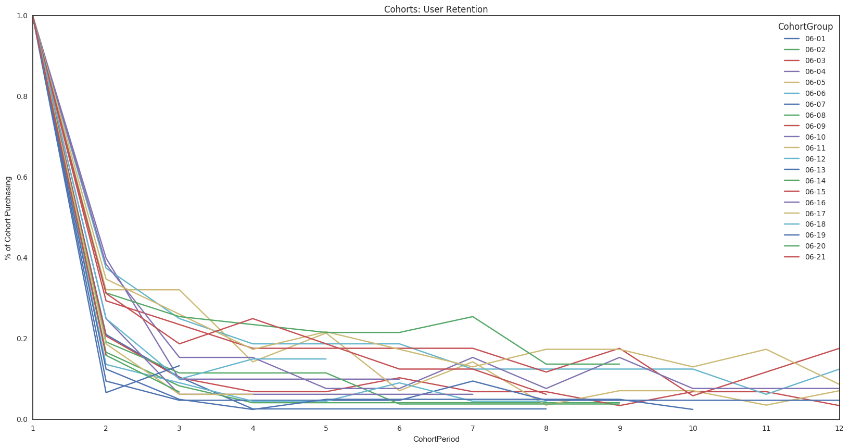
Cohort Anaysis based on Users Joining day: June 2015
Conclusion from June :-¶
70% User Leave in June on 2nd Day.
Users who join Mid June between 5th of June to 15th June have 20% Higher Chance of staying for as long as 12-19 Days

Slide 20
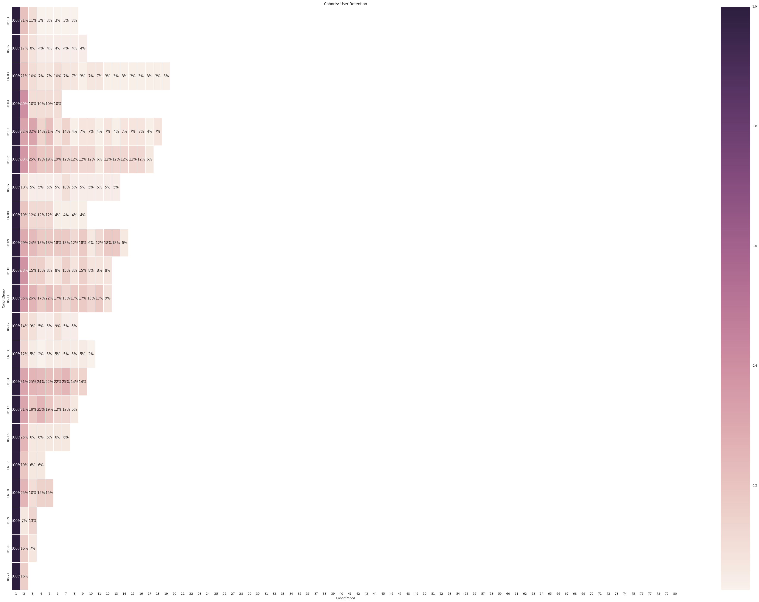

Slide 21
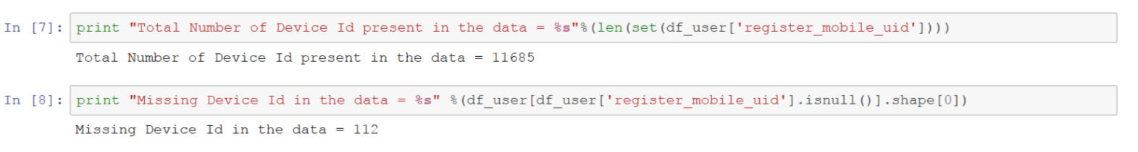
Step 2:¶ Difference in retention rate between User_id and Device_id Results can not be compared accurately . 1)as there are only 11685 Device_id VS 17916 User_id. 2)as there are more than 112 missing Device id in the dataset This produced a drastic Bias in the results.

Slide 22
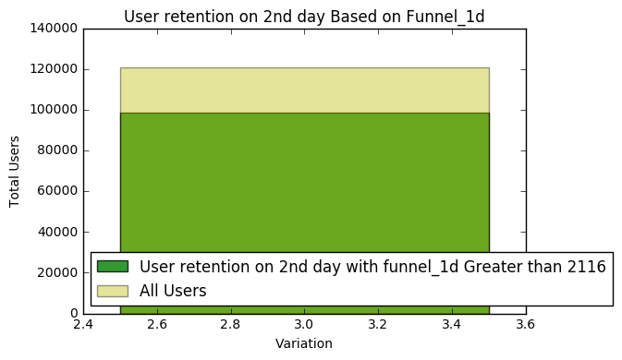
Step 3:¶
How much of the variation in the 2nd day retention can be explained by whether or not the user completed the tutorial on the 1st day. (You know if someone has complete the tutorial from the funnel steps in the user file. if funnel_1d greater than 2116 then user has completed the tutorial)
What is the significance of funnel_1d in understanding 2nd day retention.
Users with funnel_1d greater than 2116
Explain 81% Variation in 2nd Day Retention of an player.

Slide 23
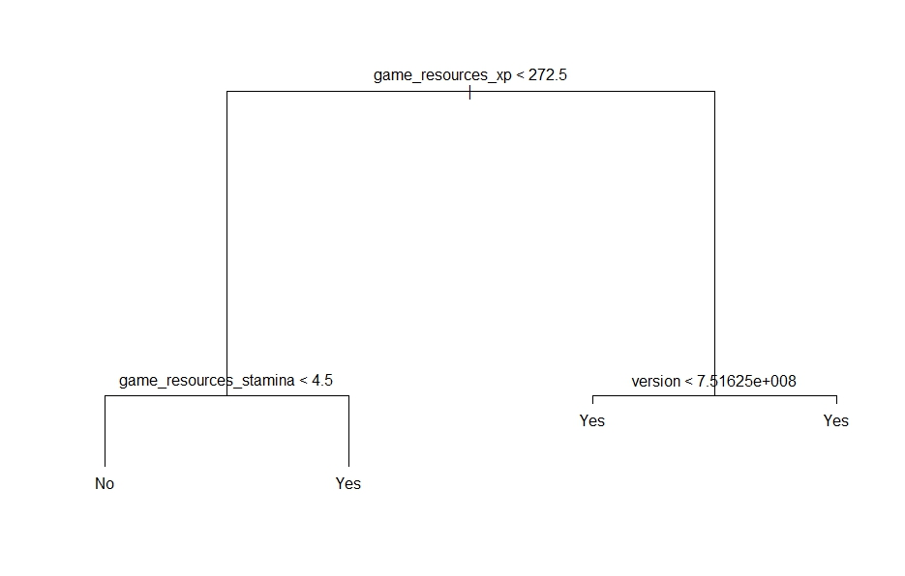
Step 4:¶ Identifying two other significant variables that we should look at to improve day 2 retention and quantify how much of the variation in retention can be explained by these variables.
The retention depends highly on player game performances:
If the user is below 272 Xp and game_resources_stamina is less than 4.5 Player Has 83% Chances to leave the application.
2) Otherwise player continues using the app on 2nd day

Slide 24
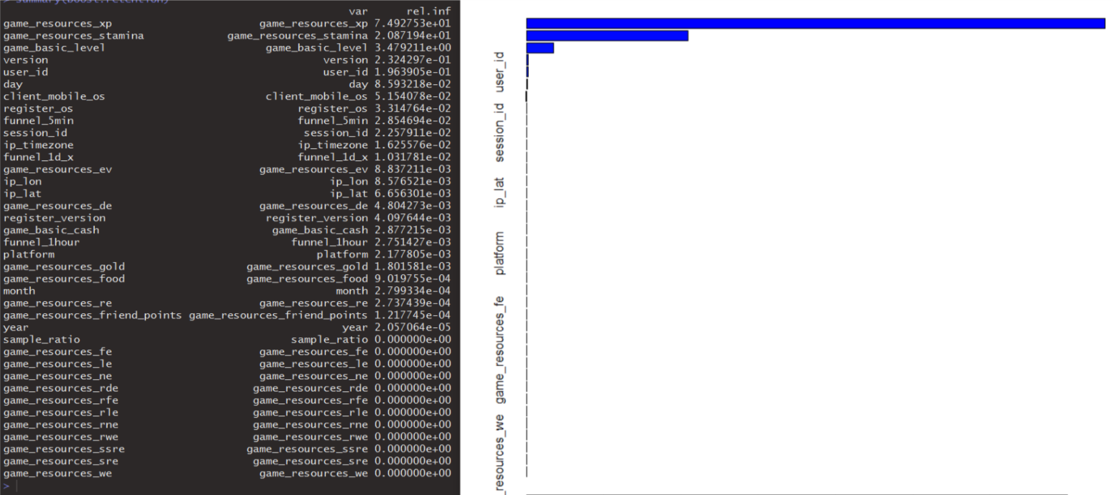
Relative influence : Of All the factors in the data on 2nd day retention including top 2.¶

Slide 25
Result:
We Notice funnel_5min has higher importance than Funnel_1d Also Version, day of the month are very important
But the most significant or generalized Features are in the game itself: 1)Game_Resource_Xp has 75% Importance in determining 2nd day retention. 2)User Stamina explains 20% of retention.

Slide 26
Thank You

